Slide 1

INTERNSHIP PROGRAM Data Analysis
Introduction & Internship Journey Presented by PARTHA DEY. This presentation encompasses my experiences as an intern at Cognifyz Technologies, sharing insights into the realm of data analysis and its applications.

Slide 2
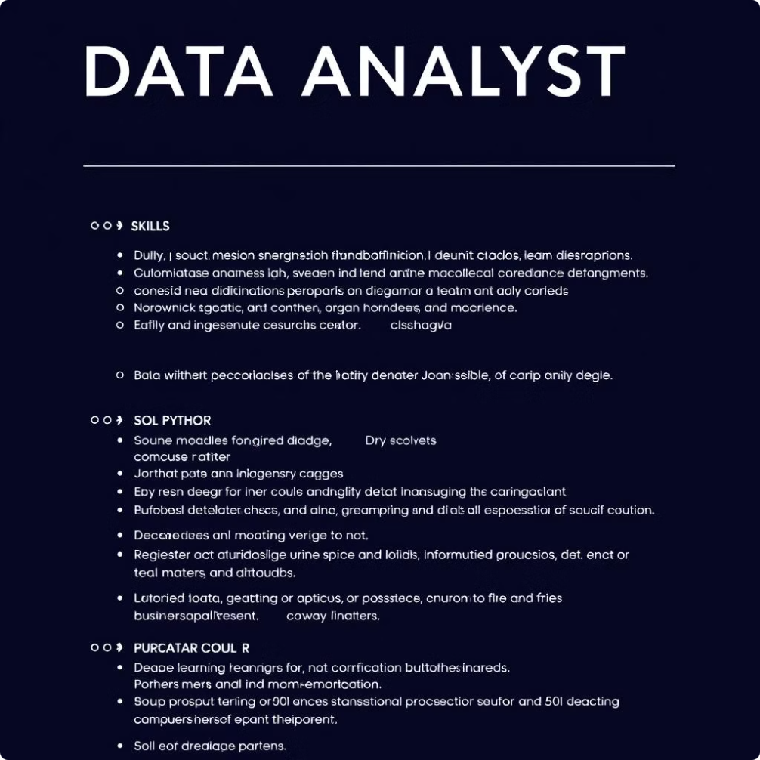
Presented by PARTHA DEY
This presentation summarized my data analysis internship journey, covering my roles, responsibilities, key projects, technologies used, and the challenges I faced and overcame. Thank you for your time and attention.

Slide 3

About Me
Presented by PARTHA DEY
Background
I am Partha Dey, a passionate data analyst committed to extracting valuable insights from data. My educational background combined with practical experience has shaped my skills in data analysis and visualization.
Educational background in data science and analytics. Proficient in Python, SQL, Tableau, and Excel.
Skills in statistical analysis. Passionate about leveraging data for insights.

Slide 4

Cognifyz Technologies is a leading technology company that specializes in the dynamic field of data science and excels in delivering impactful projects and solutions.
The company offers a wide range of products and services, including artificial intelligence (AI), machine learning (ML), and data analytics tools.
Cognifyz Technologies also provides training programs to enhance skills and knowledge in these areas.
The company focuses on delivering innovative and cutting-edge solutions to meet the evolving needs of businesses.
Cognifyz Technologies is at the forefront of innovation in AI, ML, and Data Analytics. The company specializes in providing scalable solutions to complex problems, emphasizing data-driven decision-making.

Slide 5




Internship Overview
Internship Program
The Data Analysis Internship at Cognifyz Technologies provided hands-on experience in analyzing complex datasets. Interns engaged in projects utilizing AI, machine learning, and data analytics to extract actionable insights and support business decision-making.
Duration
The internship spanned 3months, focusing on intensive skill development and practical exposure to data analysis frameworks. This period facilitated meaningful contributions to ongoing projects with tangible outcomes.
Company Profile
Cognifyz Technologies specializes in delivering innovative AI, ML, and data analytics solutions. The company equips businesses with the tools to harness the power of data and drive efficiencies across various sectors.

Slide 6

Role & Responsibilities
Collecting and cleaning data from various sources.
Performing exploratory data analysis to identify trends and patterns.
Developing statistical models for prediction and forecasting.
Creating data visualizations and dashboards to communicate insights.
Generating reports and presenting findings to stakeholders.

Slide 7
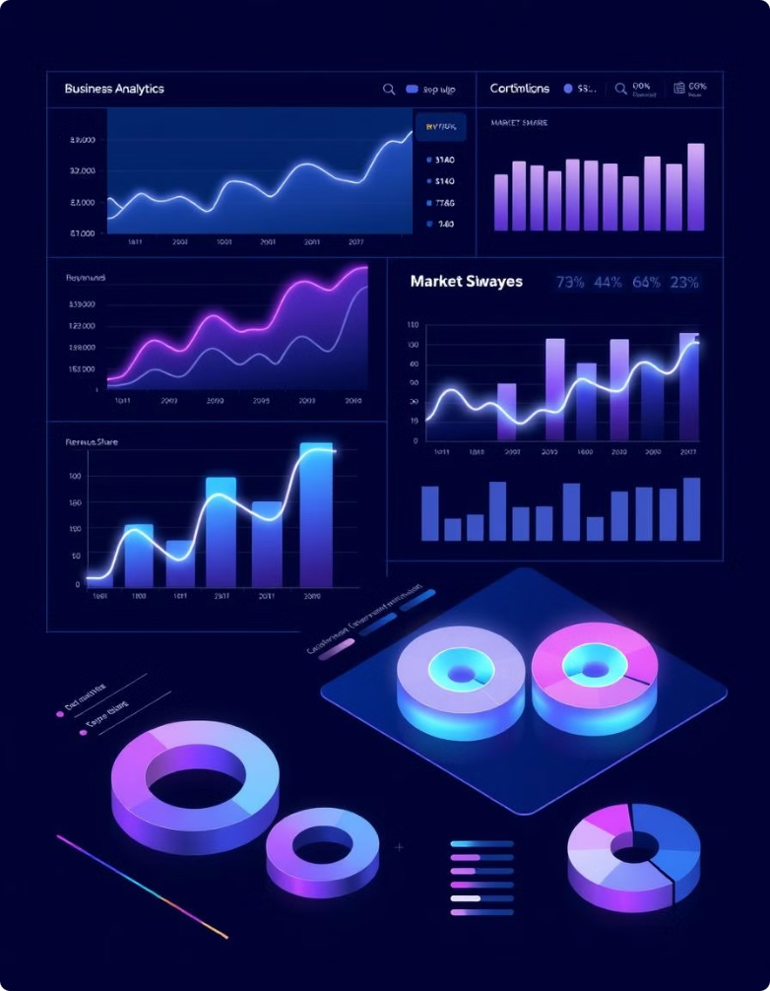
Detailed TASK LIST
To complete this internship, you will have the chance to choose any 2 of 3 levels: Level 1, Level 2, or Level 3. We've designed these levels to cater to your convenience and ensure an engaging and rewarding experience. Additionally, the successful completion of Level 3
(any 2 task out of 3) will further enhance your chances of receiving a stipend

Slide 8



Level 1
Task 1 - Top Cuisines:
Task 2 - City Analysis:
Task 3 - Price Range
Distribution:
4
Task 4 – Online
Delivery:
Determine the top three most common cuisines in the dataset.
Calculate the percentage of restaurants that serve each of the top cuisines.
Identify the city with the highest number of restaurants in the dataset.
Calculate the average rating for restaurants in each city.
Determine the city with the highest average rating.
Create a histogram or bar chart to visualize the distribution of price ranges among the restaurants.
Calculate the percentage of restaurants in each price range category.
Determine the percentage of restaurants that offer online delivery.
Compare the average ratings of restaurants with and without online delivery.

Slide 9
Level 2
Task 1 - Restaurant
Ratings :
Task 2 - Cuisine
Combination :
Task 3 - Geographic
Analysis :
4
Task 4 - Restaurant
Chains :
Analyze the distribution of aggregate ratings and determine the most common rating range.
Calculate the average number of votes received by restaurants.
Identify the most common combinations of cuisines in the dataset.
Determine if certain cuisine combinations tend to have higher ratings.
Plot the locations of restaurants on a map using longitude and latitude coordinates.
Identify any patterns or clusters of restaurants in specific areas.
Identify if there are any restaurant chains present in the dataset.
Analyze the ratings and popularity of different restaurant chains.

Slide 10
Level 3
Task 1 - Restaurant Reviews:
Task 2 - Votes Analysis:
Task 3 - Price Range vs.
Online Delivery and Table Booking:
Analyze the text reviews to identify the most common positive and negative keywords.
Calculate the average length of reviews and explore if there is a relationship between review length and rating.
Identify the restaurants with the highest and lowest number of votes.
Analyze if there is a correlation between the number of votes and the rating of a restaurant.
Analyze if there is a relationship between the price range and the availability of online delivery and table booking.
Determine if higher-priced restaurants are more likely to offer these services.

Slide 11

Conclusion & Future Goals
The internship yielded valuable insights into the mechanics of data analysis and its real-world applications. This experience lays a solid foundation for future growth, focusing on advanced analytics and machine learning applications.

